Slide 1
Btech(csbs)
UNIT-III
CHI-SQUARE, t, AND F DISTRIBUTIONS

Slide 2
Chi Square Distribution
The Chi Square distribution is the distribution of the sum of squared standard normal deviates.
Let X1, X2, . . . , Xv be v independent normally distributed random variables with mean zero and variance 1. Consider the random variable
The degrees of freedom of the distribution is equal to the number of standard normal deviates being summed.
Therefore, Chi Square with one degree of freedom, written as χ²(1), is simply the distribution of a single normal deviate squared.

Slide 3
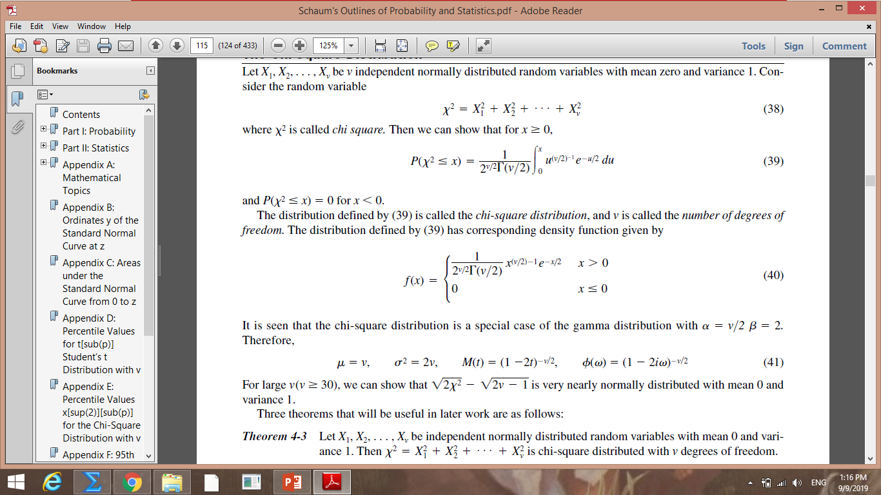
The distribution has corresponding density function given by

Slide 4
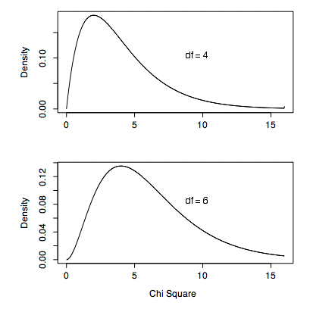

Slide 5
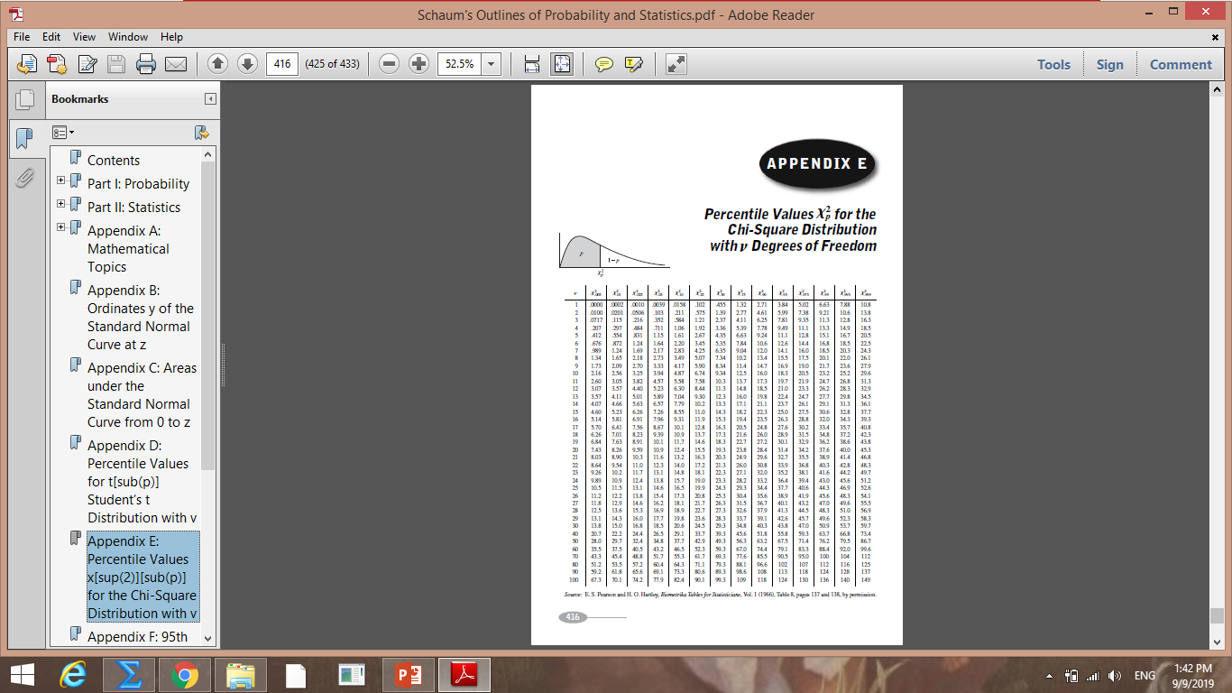

Slide 6
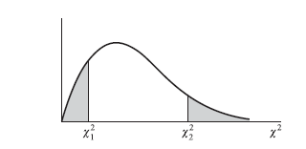
The graph of the chi-square distribution with 5 degrees of freedom is shown in Fig. Find the values for which
(a) the shaded area on the right 0.05,
(b) the total shaded area 0.05,
(c) the shaded area on the left 0.10,
(d) the shaded area on the right 0.01.

Slide 7
Find the values of for which the area of the right-hand tail of the distribution is 0.05, if the number of degrees of freedom v is equal to
15,
21,
50.

Slide 8
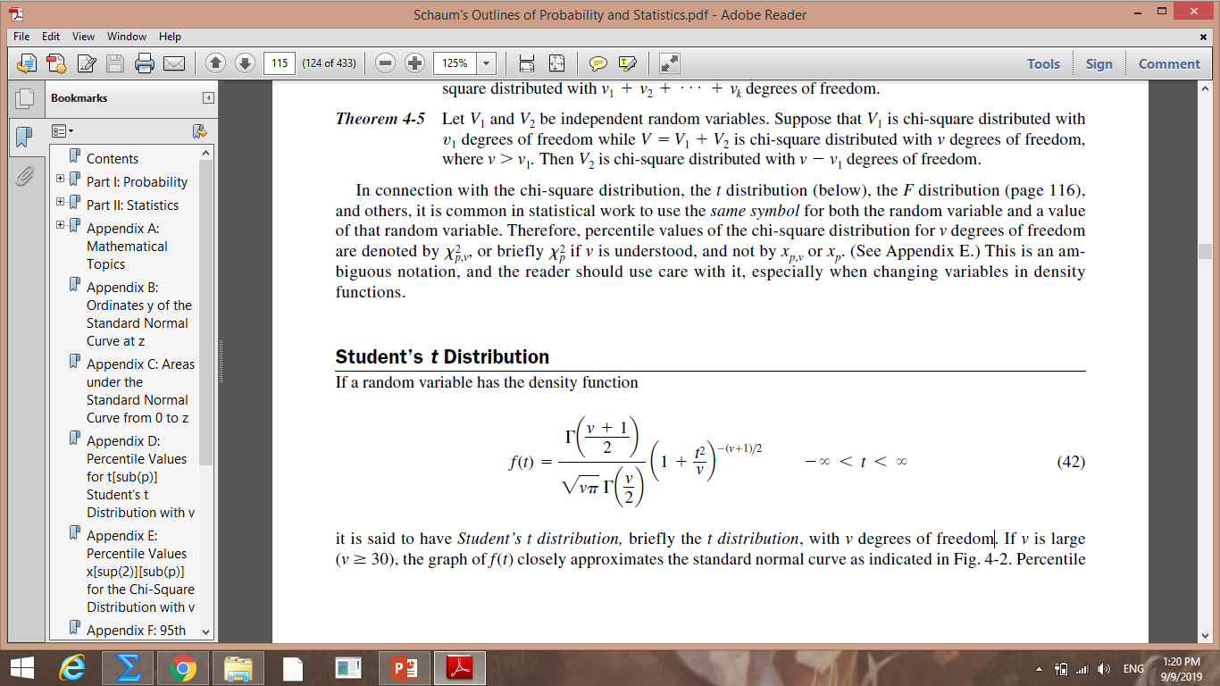
Student’s t Distribution
A T distribution is a type of probability distribution that is similar to the normal distribution with its bell shape, but has heavier tails (i.e., greater chance for extreme values)
If a random variable has the density function
it is said to have Student’s t distribution, briefly the t distribution, with v degrees of freedom

Slide 9
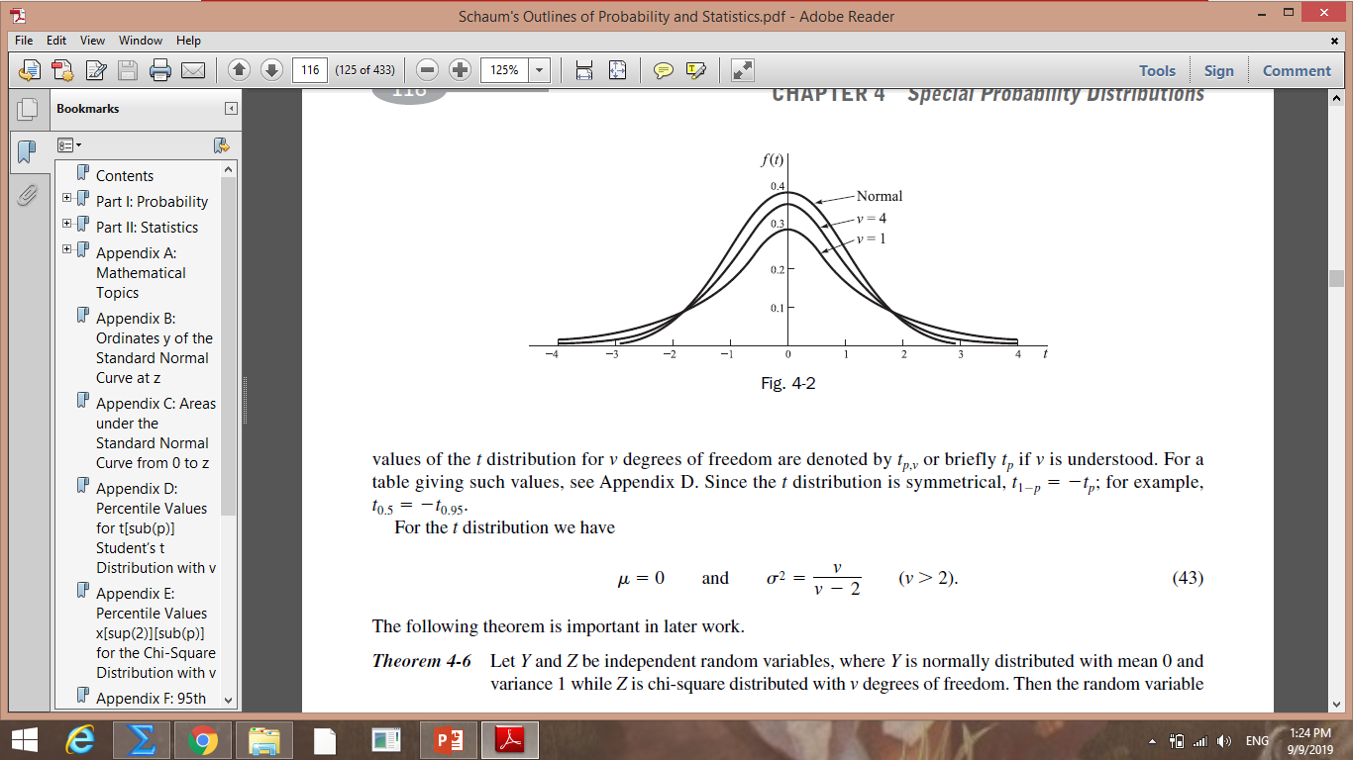
If v is large (v >30), the graph of f (t) closely approximates the standard normal curve.

Slide 10
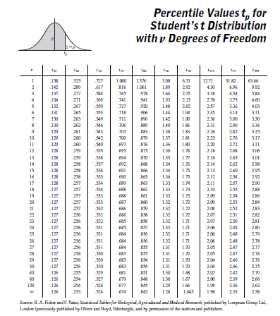

Slide 11
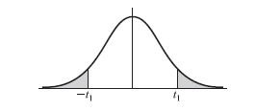
The graph of Student’s t distribution with 9 degrees of freedom is shown in Fig. 4-19. Find the value of t for which
(a) the shaded area on the right 0.05,
(b) the total shaded area 0.05,
(c) the total unshaded area 0.99,
(d) the shaded area on the left 0.01,
(e) the area to the left of t1 is 0.90.

Slide 12
Find the values of t for which the area of the right-hand tail of the t distribution is 0.05 if the number of degrees of freedom v is equal to
16,
27,
200.

Slide 13
F Distribution
The F-distribution is a skewed distribution of probabilities similar to a chi-squared distribution.
But where the chi-squared distribution deals with the degree of freedom with one set of variables, the F-distribution deals with multiple levels of events having different degrees of freedom.

Slide 14
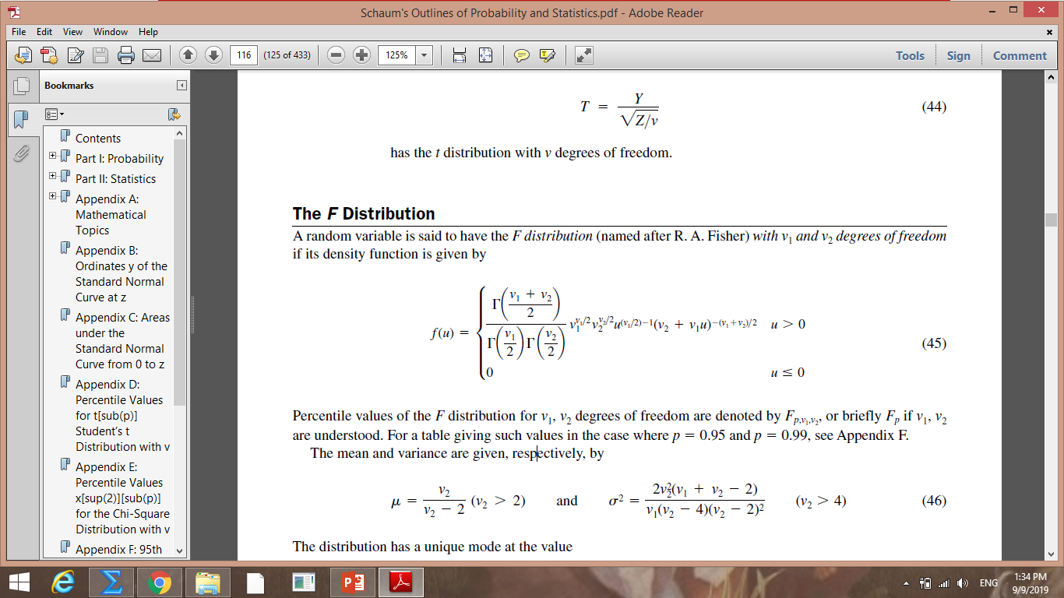
A random variable is said to have the F distribution (named after R. A. Fisher) with v1 and v2 degrees of freedom if its density function is given by

Slide 15
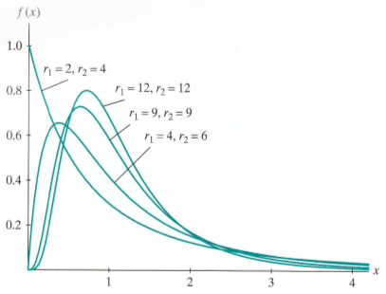

Slide 16
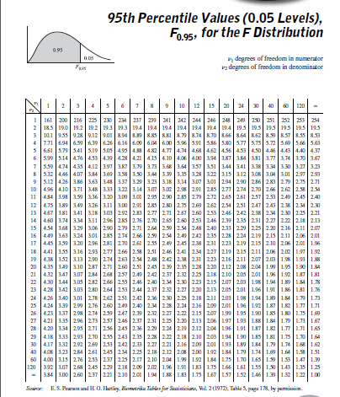

Slide 17
Using the table for the F distribution in Appendix F, find
F_{0.95,10,15},
F_{0.99,15,9},
F_{0.05,8,30},
F_{0.01,15,9}.

Slide 18


